Slide 1


Federal Market
Mastery
PRESENTED BY: Neil McDonnell
DATE: October 09, 2026

Slide 2


ABOUT ME
Neil McDonnell
President / GovCon Chamber
Army Vet w/20+ Years Federal Market
Built & Sold Two GovCon Businesses
Trained Tens of Thousands on GovCon

Slide 3


LEARNING OUTCOMES
OVERVIEW
Clearly define what you sell and identify a focused market niche based on what customers actually buy from you.
Identify priority federal customers and strategic partners where you can build deeper market position.
Use customer-discovery conversations to uncover problems and engage customers earlier in buying cycle.
Translate these decisions in a practical Sales Strategy Wheel connecting customers, relationships, opportunities and future revenue.

Slide 4

Agenda
State of the Federal Market
What We Actually Sell
Go Deep or Go Narrow
Stop Finding Opportunities – Create Them
Customer Discovery / Relationship Building
Build Your Federal Sales Strategy

Slide 5



State of the Federal Market

Slide 6
Federal Market Today
Federal Government is Open for Business
  Fiscal Year 2027 Operating Under a Continuing Resolution
  Funding Runs Through December 11th
Buying Continues But Market is Changing Fast
  FAR Being Rewritten
  Rules Being Simplified
  Procurement Being Centralized / Fewer Buying Channels
  More Government-Wide Buying

Slide 7
Competition is Changing
SBA Proposing Much Larger Size Standards
Very Bad for Small Businesses – But is what it is…
More Competition in Set Asides / Set Asides Still Under Threat
AI-Enabled Competition Increases Volume / Decreases PWin

Slide 8
What Winning Looks Like Now
Specialization – a Clear, Focused Offer
Customer Knowledge & Intimacy
Early Engagement with Federal Buyers
Strategic Relationships & Teaming
Persistence and Follow Through – Never Give Up!

Slide 9
What Concerns You?
Let’s Name Our Fear – Understand It – Minimize It
What Are You Hearing?
What Are You Worried About?
What Are You Seeing?
What Questions Do You Have About the Market?

Slide 10
What We Actually Sell

Slide 11
Be Known For One Thing
You Don’t Get Remembered for Everything
You Get Remembered for One Thing
Buyers Do Not Buy Everything
They Buy One Thing From Someone They Know Will Deliver
$100M Small Business Selling Data Analytics to CMS
You Can Build a Very Large Company From One Thing

Slide 12
The Power of Being Typecast
Being Typecast Can Be Valuable
Ask Matthew McConaughey
Reliable Rom-Com Money Maker
Known By Everyone Who Wanted to Make a Rom-Com
Everyone Knew Who To Call

Slide 13
Federal Buyers Typecast You Too
The Data Analytics Company
Patient Care Training Company
The “SharePoint Guys”
  Early Contracts: Admin / OOTB Development
  Later Contracts: Architecture, Migrations, Records Management, EA…
  Organic Growth in Federal Market
What Do You Want Them to Call You?

Slide 14
Core Offer vs. Enablers
Core Offer: What Customers Hire You To Do
Enablers: Skills Required To Deliver It
Core Offer: SharePoint
Enablers: Project Management, Training, Process Improvement
Do Not Confuse What Helps You Deliver With What You Sell

Slide 15
What Do You Say You Sell?
Mission Support
IT Services
Construction
Professional Services
Consulting
Training
What Does That Actually Mean?

Slide 16
Follow the Money
What Have Customers Paid For?
What Work Repeats?
Where is Your Strongest Proof?
What Do Buyers Already Trust You To Do?
Past Performance Tells the Truth!

Slide 17
Exercise 1 – What Do You Sell?
We say we sell: _________________
Customers actually pay us for: ____________________

Slide 18
Narrow it Down
Instead of: We Do Training
Move Toward: Healthcare Training
Then: Patient Care & Hospital Safety Training
Specificity Makes You Easier to Understand and Remember

Slide 19
You Can Expand Later
Start Narrow
Build Credibility
Become Known
Expand From Strength
Narrow Does Not Mean Small
Build $100M Company Selling One Thing

Slide 20
Exercise 2 – Build the Offer
We help___________________________________
solve_____________________________________
by providing________________________________
Our strongest proof is_________________________.

Slide 21
The Test
Can a Buyer Repeat It?
Can a Partner Understand It?
Does Your Past Performance Prove It?
Does It Lead to a Clear Customer?
If They Can’t Remember It, They Can’t Restate it.

Slide 22
Go Deep or
Go Narrow

Slide 23
Go Deep or Go Narrow
You Can’t Sell to Everyone
Focus Creates Traction That Will Last for Years
There Are Two Ways to Focus
Go Deep Into One Department
Go Narrow Across Most Departments

Slide 24
Go Deep
Pick a Customer and Know Them Better Than Anyone
One Department Like Veterans Affairs (VA)
Depth Creates Compounding Relationships

Slide 25
Example: Go Deep
Department of Veterans Affairs
Veterans Health Administration
Regions
VISNs
VAMCs & CBOCs
This Built My Last Company’s First $10M ARR

Slide 26
Go Narrow
Pick a Problem You Solve Exceptionally Well
One Problem
One Offer (Solution, Product, Service)
One Great Story
Many Customers (Agencies)
Narrow Creates Expertise

Slide 27
Example: Go Narrow
SharePoint Migration
SharePoint Architecture & Administration
SharePoint Development
Records Management on SharePoint
VA, Army, DHS, White House, Air Force, DoT, Ed
Same Problem. Same Solution. More Customers.

Slide 28
The Sweet Spot
Go Deep + Go Narrow
Specific Customer
Specific Problem
Specific Offer
Specific Proof
Become the Obvious Choice

Slide 29
Exercise 3 – Where Will You Focus
Go Deep – Which Agency? _________________
Go Narrow – Which Offer? _________________
Which Gives You More Traction Today? Deep or Narrow

Slide 30
Focus Means Saying No
Not Every Agency
Not Every Opportunity
Not Every Capability
Not Every Partner
Every “No” Protects Your Focus

Slide 31
Focus Builds Momentum
Easier Messaging
Better Relationships
Stronger Past Performances
More Referrals
More Repeat Business

Slide 32
Stop Finding Opportunities –
Create Them

Slide 33
Stop Finding Ops. Create Them.
Most Companies Enter Too Late
Everyone Sees the Same RFP
Earlier = More Influence
Earlier = Better Insight
Earlier = Better Positioning

Slide 34

The Federal Buying Journey
Relationship Strength & Influence
Strong
Weak
Business Development / Capture
Requirement
Exploration
Market Research
RFP
Phase
Award
Execution
Informal
Formal
Informal

Slide 35
Stage 1: Idea / Need Identified
New Idea Emerges (AI solution)
Problem Becomes Obvious (Elevator broken)
Mission Need Appears (New hospital capacity)
Shortage or Failure Occurs (Long deployments in Iran)
This is the Best Place to Create Demand!

Slide 36
Stage 2: Requirement Exploration
Program Office Investigates
Informal Market Research
Internet / AI / Peers
Industry Conversations
No Formal Acquisition Involvement Yet
You Can Help Them Understand the Problem

Slide 37
Stage 3: Opportunity Visibility
Acquisition Forecasts
Expiring Contracts
Known Recompetes
Early Opportunity Signals (Industry Days)
Now Competitors Can See It Too

Slide 38
Stage 4: Formal Market Research
Request for Information (RFI)
Sources Sought Notice
Industry Engagement
Requirement Refinement
Acquisition Strategy Developing
Influence is Still Possible, But Shrinking

Slide 39
Stage 5: RFP Drops
Requirement is Defined
Acquisition Strategy is Set
Everyone is Responding
You Now Have No Influence… Just a Lot of Competition

Slide 40
How To Get Engaged Earlier
Know Your Target Customer
Know the Problems You Solve
Build Relationships Before You Need Them
Ask Better Questions
Share Ideas and Lessons, Not Capabilities
Stay Engaged

Slide 41
The Goal
Do Not Ask: Where are the opportunities?
Ask: Where are the problems?
Problems Become Requirements.
Requirements Become Opportunities.

Slide 42
Customer Discovery & Relationship Building

Slide 43
Stop Pitching. Start Learning
Their Mission
Their Problems
Their Priorities
Their Obstacles
Their Desired Outcome

Slide 44
The Goal of a Meeting
Not Presenting Your Capabilities
Not Walking Through Your Deck
Not Telling Them Everything You Do
Understand Their World
Discover Problems
Earn the Next Conversation

Slide 45
Ask Questions That Open Doors
SPIN Selling
What are you responsible for?
What’s changing within your office or agency?
What’s difficult today?
What’s not working for you?
What keeps coming up?

Slide 46
Then Go Deeper
Why is this a problem?
Who does it affect?
What happens if nothing changes?
What have you already tried?
What would ‘better’ look like?
Don’t Rush to Your Solution.
Help Them Become Problem Aware.

Slide 47
Listen for Pain / Implied Needs
Frustration
Delay
Costs
Risks
Workarounds
Complaints
Problems Become Requirements Which Become Opportunities

Slide 48
Build Strategic Relationships
Networking Buddies
Opportunity Teammates
Strategic Relationships
Commitment to Mutual Growth
Similar Organizational Maturity
Disciplined and Process Driven

Slide 49
Build Your Federal Sales Strategy

Slide 50

The Power of Focus

Slide 51
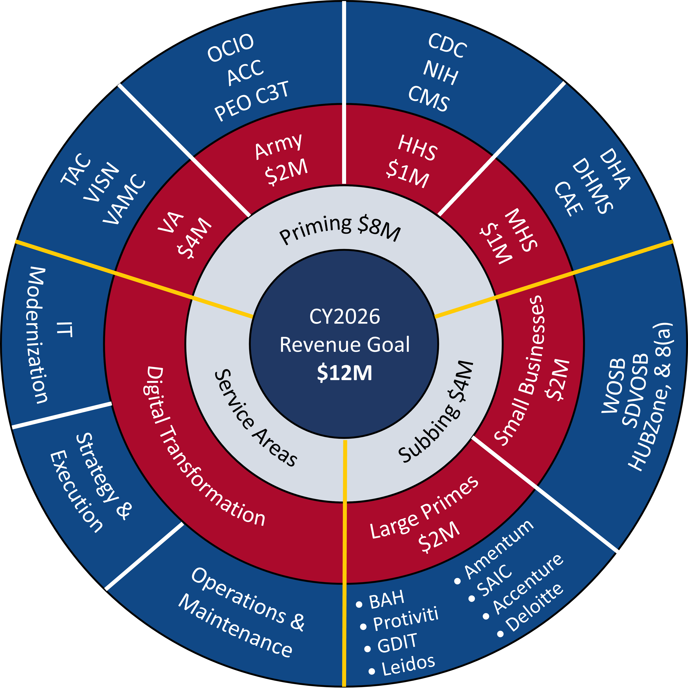

Slide 52
Key Takeaways

Slide 53
Key Takeaways
Have a Clear, Focused Offer
Be Purposeful About Deep or Narrow
Get There at the Idea Stage

Slide 54





Stay In Touch
+703-627-5360
Neil@govcon123.com
Neil McDonnell
www.GovCon123.com

