Slide 1

DAY 2
Crystal Farh
farh@uw.edu
September 24, 2025
Notes:
Excited to be here to talk about leadership
For the past 15 years, I’ve studied and taught and consulted on various facets of this topic
Including authentic leadership, team leadership, creative leadership
But what that bio does not tell you is my own experience with scaling came right from home

Slide 2
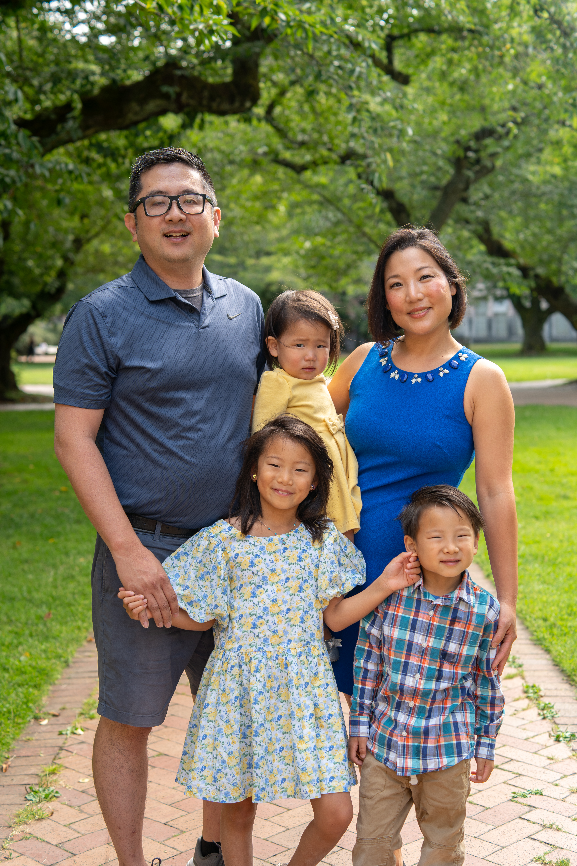

My Own Experience with Scaling
Notes:
Folks often talk about entrepreneurs and their businesses like parents and their babies.
So I hope you won’t mind if I share these family photos.
Because as I was putting together the materials for today’s session, I couldn’t help but notice how many parallels there were between scaling a business and growing a family.
It forced me to grow as a parent/leader: no more undivided attention and resources for one child; I had to be willing to shift my mindset from being person-centric to system-centric, establishing routines, responsibilities, and systems to manage the household. Scaling a business similarly requires shifting from doing all the work to building a system that others can operate. That involves putting processes into place, delegating tasks, and shifting from tactics to strategy.
It forced me to grow my team: I needed to get childcare providers, tutors and coaches, and grandparents involved. I needed to figure out which team members were best positioned to meet each individual’s unique needs, which by the way, evolve; and I needed to work through inevitable conflict between parties (e.g., husband and in-laws) and get everyone to play as a team. Scaling a business similarly requires building your team, plugging skill gaps with new hires, and managing potential faultlines between the existing “old guard” and “new blood.”
And it forced me to constantly be in a place of continuous learning and adaptation: Kids grow up, their needs change. That means as a family we have to constantly reinvest to stay healthy and functional, while also retaining a “family brand” of values, rituals, and shared culture that is core to our identity. Scaling a business requires constantly innovating, being ready to adjust structures and priorities to meet new challenges and stay competitive in the market, while also defining and reinforcing a company culture that serves as a moral compass for decision-making and help the company grow cohesively as new employees join.

Slide 3
Leadership Strategies for Scaling
2:00-5:00
Growing
A Culture of Innovation
How do you foster a culture where great ideas are developed, nurtured, and bring competitive advantage?
11:00-12:30
Growing
Your Team
What strategic factors should you consider when growing your team?
9:00-10:45
Growing
Yourself
To prepare for growth, what must shift in who you are as a leader?
Notes:
Email all material a week before (printouts etc., powerpoints)
9 a.m. actual content start but be there at 8
Take an hour ½ lunch somewhere in there
End at 5
N = 50
I’m going there are at least three ways in which your mindset has to shift, has to grow.
One is, growing who you are as a leader.
Two is, growing your team.
Three is, growing

Slide 4

A Fitting Metaphor: New Wine, New Skins
Notes:
Is anyone familiar with the metaphor? They used to age wine in wineskins; but the aging and fermenting process would stretch the skins; so if you try to put new wine into an old wine skin, it would break. Rather, you had to put new wine into new skin.
And that’s the premise of today’s session: To grow your business, you have to be prepared to grow yourself, and possibly shift the mindset you’ve carried with you for a very long time.

Slide 5



Leadership Identity
Your core values
Your motivators & passions
Your leadership strengths
Entrepreneurial Leadership
Your reasons for becoming an entrepreneur
The way you lead your business

Slide 6
Leadership Identity in Action
Leadership Purpose
Motivators
& Passions
Leadership Strengths
Core
Values
Triumphs
Gifts
Crucibles
Upbringing
Role models
Beliefs
Meaning
Life experiences
Notes:
Before we know how we need to adapt our leadership, we need to know how we are currently operating as a leader. Here’s a helpful map.
This is the authentic leadership grid. Authentic leadership hinges on the idea that every leader has core values that are actualized in the form of a purpose statement. One’s authentic leadership is not just the purpose statement, but also how you rely on your greatest motivators and strengths to carry it out. Therefore, someone with the same core values can result in a very different purpose statement and enact that statement very differently on account of those unique motivations and strengths.

Slide 7


Leadership Identity & Readiness for Growth
“In my research on leadership transitions, I have
observed that career advances require all of us to
move way beyond our comfort zones. Yet we tend to latch on to our leadership identity as an excuse for sticking with what’s comfortable.
By viewing ourselves as works in progress and evolving our leadership identities through trial and error, we can develop a personal style that feels right to us and suits our organizations’ changing needs.”
Herminia Ibarra (Professor, London Business School)
“Leadership identity is a dynamic thing. It is like writing something on page one of your journal…in pencil.”
Clyde Walker (VP of HR, Continental Mills)

Slide 8
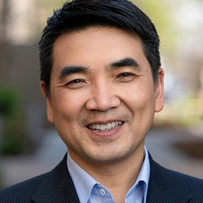




Mini-Cases (or Generate Your Own!)
Read and Discuss:
How would you describe the shift in leadership identity these individuals experienced as they grew their business? What changed? What stayed the same?
Notes:
Exercise:
-Have everyone articulate their leadership purpose and where it comes from
-Have everyone identify what their entrepreneurial leadership has been so far

Slide 9
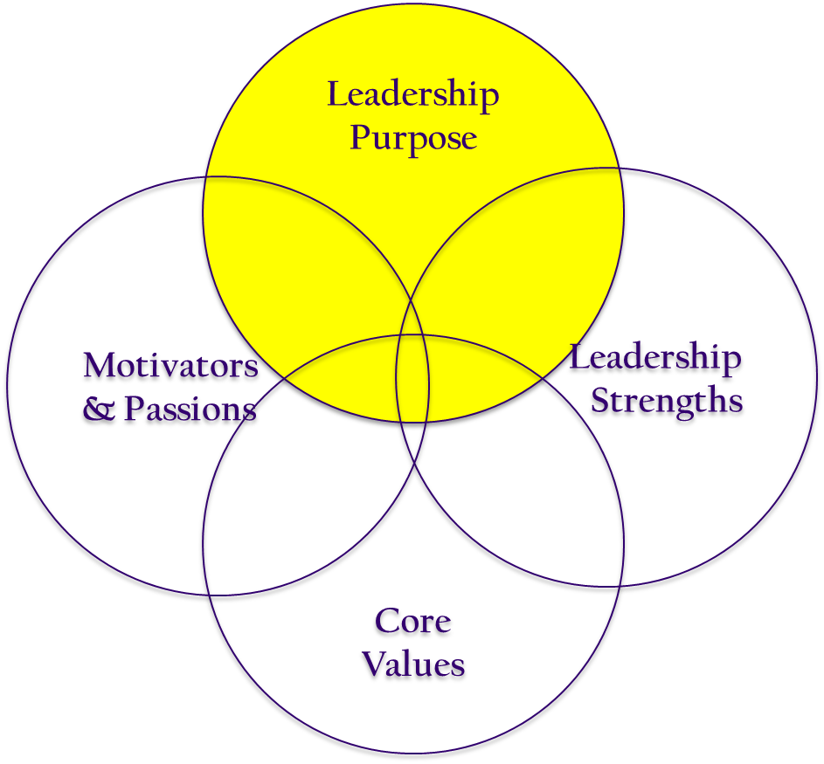
In Other Words…
New approach of leveraging your leadership strengths, motivators, and passions to live out your leadership purpose
STATUS QUO
Current approach of leveraging your leadership strengths, motivators, and passions to live out your leadership purpose
Notes:
You might not be changing your core values, but you’re adjusting the way they translate into action. You might be actualizing a different aspect of your purpose than you used to. You might be leveraging your leadership strengths in a different way and possibly discovering new strengths you did not previously rely on. You might be reframing your motivations.

Slide 10

REFLECT AND APPLY
10 min: Share the leadership identity grid you completed for today. How do your core values shape your leadership purpose? How do you currently leverage your leadership strengths, motivators, and passions to live out your leadership purpose?.
20 min: On the post-it provided, write down one scaling plan that you drafted on Day 1. Place this post-it next to your leadership identity grid. How well does this scaling plan draw on/connect to your current leadership purpose? How can your leadership identity grid be expanded/reframed to support this scaling plan? (E.g., require a new interpretation of your core values, leverage different strengths, or tap into your motivators & passions in new ways?)

Slide 11
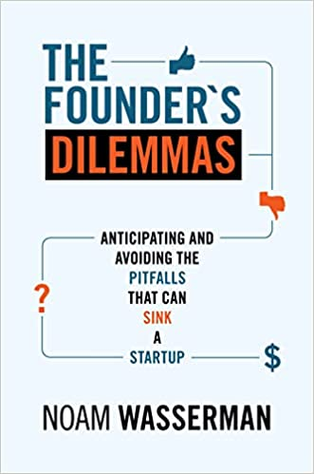
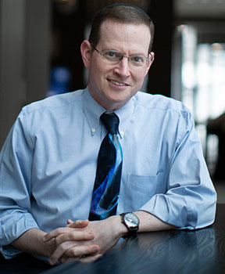
Leadership Identity
Your core values
Your motivators & passions
Your leadership strengths
Entrepreneurial Identity
Your reasons for becoming an entrepreneur
The way you lead your business
Notes:
Research has also shown that when one of the reasons for getting entrepreneurship is the “kingdom” motivation, growth can be hard… because most of the time, growth means giving up control in order to attain more riches. This can present a real barrier to growth, unless you come to terms with the fact that you might have to give up control.

Slide 12
Instructions: For each statement, indicate how much you agree or disagree using the following scale (1 = strongly disagree, 2 = disagree, 3 = neutral, 4 = agree, 5 = strongly agree)
Achieving high financial returns is my primary motivation for running my business.
I focus on financial metrics and profitability when making business decisions.
My main goal is to maximize the valuation of my company for a lucrative exit.
I prefer pursuing business strategies that offer quick financial gains, even if they involve short-term risks.
I regularly seek out high-value investors and partnerships that can significantly increase my company’s financial worth.
Maintaining control over my company's direction and decisions is more important to me than financial rewards.
Building a lasting legacy and making a meaningful impact in my industry or community is my top priority.
I prefer to retain ownership and decision-making power, even if it means limiting growth opportunities or financial gains.
Creating a strong company culture and aligning the business with my personal values is crucial to me, even over financial success.
I am more focused on the long-term vision of the company and its impact rather than immediate financial returns.

Slide 13

Patterns of Entrepreneurial Leading
“Rich” Pattern
Leadership is focused on financial gain and economic benefits.
Entrepreneurs following this pattern are primarily motivated by wealth creation and financial success. Their decisions are often driven by maximizing personal and financial returns.
“Kingdom” Pattern
Leadership is centered around control, influence, and the legacy of the business.
Entrepreneurs who adopt this pattern are primarily motivated by maintaining control over their company, shaping the company’s long-term vision, and establishing a lasting legacy.
Source: “The Founder’s Dilemmas”
Notes:
“Rich” – founders who consistently make decisions that build wealth (greater financial gains, lesser control)
“King” – founders who consistently make decisions that enable them to maintain control o the startup (greater control, lesser financial gains)
Which are you?

Slide 14
“Rich” vs. “Kingdom”: Circle as You Go!
 | Decisions Oriented toward Maximizing Wealth | Decisions Oriented toward Maintaining Control
Approach toward Co-founders | Attract best (and complementary) cofounders for founding team | Remain solo founder or look to immediate circle for “comfortable” cofounders
 | Give decision-making control to cofounders with expertise in specific areas | Keep strong control of decision-making; hierarchies
 | Share equity to attract and/or motivate cofounders | Maintain most of all equity ownership
Source: “The Founder’s Dilemmas”
Notes:
“Rich” – founders who consistently make decisions that build wealth (greater financial gains, lesser control)
“King” – founders who consistently make decisions that enable them to maintain control o the startup (greater control, lesser financial gains)
Which are you?

Slide 15
“Rich” vs. “Kingdom”: Circle as You Go!
 | Decisions Oriented toward Maximizing Wealth | Decisions Oriented toward Maintaining Control
Approach toward Building Internal Team | Aggressively tap broader network (unfamiliar candidates) to find the best | Hire within close, trusted personal network (friends, family, others)
 | Delegate decision-making to appropriate expert | Keep control of key decisions
 | Hire experienced employees and incent them with cash and equity | Hire less expensive and less experienced junior employees
Source: “The Founder’s Dilemmas”
Notes:
“Rich” – founders who consistently make decisions that build wealth (greater financial gains, lesser control)
“King” – founders who consistently make decisions that enable them to maintain control o the startup (greater control, lesser financial gains)
Which are you?

Slide 16
“Rich” vs. “Kingdom”: Circle as You Go!
 | Decisions Oriented toward Maximizing Wealth | Decisions Oriented toward Maintaining Control
Approach toward Building External Team | Take outside capital; or Target experienced angels or venture capitalists | Self-fund; or friends and family or money-only angels
 | Open to terms necessary to attract best investors (e.g., supermajority rights) | Resist investor-friendly terms (e.g., refuse supermajority rights)
 | Get best investors and directors, even if it means losing control of the board | Avoid building official board; when built, control composition and makeup
Source: “The Founder’s Dilemmas”
Notes:
“Rich” – founders who consistently make decisions that build wealth (greater financial gains, lesser control)
“King” – founders who consistently make decisions that enable them to maintain control o the startup (greater control, lesser financial gains)
Which are you?

Slide 17
“Rich” vs. “Kingdom”: Circle as You Go!
 | Decisions Oriented toward Maximizing Wealth | Decisions Oriented toward Maintaining Control
Approach toward Succession & Growth | Open to initiating succession or change position when next stage of startup if outside one’s own expertise | Resist giving up the CEO position; rather leave than remain “prince”
 | Prefer fast to explosive rate of startup growth | Prefer gradual to moderate rate of startup growth
Outcome | Build financial value; imperil control | Maintain control; build less value
Source: “The Founder’s Dilemmas”
Notes:
“Rich” – founders who consistently make decisions that build wealth (greater financial gains, lesser control)
“King” – founders who consistently make decisions that enable them to maintain control o the startup (greater control, lesser financial gains)
Which are you?

Slide 18
REFLECT AND APPLY
10 min: What has your entrepreneurial identity been? Discuss the results of your entrepreneurial leadership pattern results with your partner. Do you see yourself oriented more towards maximizing control or maximizing wealth?
20 min: Choose one scaling plan that you drafted on Day 1. (OK to use the same one as in the earlier exercise or a new one.) Now, revisiting the patterns of leading you circled earlier, consider what adjustments would be needed to support this new scaling plan. What aspects of your current entrepreneurial identity might be holding you back?

Slide 19
Growing Yourself: Takeaways
An overly rigid sense of leadership identity can prevent you from pursuing growth. Likewise, your motivations for being an entrepreneur can also lead to patterns of behavior that sabotage growth.
If reframed to align with growth, your leadership and entrepreneurial identities can infuse that growth with meaning and prepare you to make changes in your leadership that support the growth.
YOUR takeaways?

Slide 20

Let’s Take a Break!
Notes:
https://www.truity.com/test/big-five-personality-test

Slide 21
Leadership Strategies for Scaling
2:00-5:00
Growing
A Culture of Innovation
How do you foster a culture where great ideas are developed, nurtured, and bring competitive advantage?
11:00-12:30
Growing
Your Team
What strategic factors should you consider when growing your team?
9:00-10:45
Growing
Yourself
To prepare for growth, what must shift in who you are as a leader?
Notes:
Email all material a week before (printouts etc., powerpoints)
9 a.m. actual content start but be there at 8
Take an hour ½ lunch somewhere in there
End at 5
N = 50
I’m going there are at least three ways in which your mindset has to shift, has to grow.
One is, growing who you are as a leader.
Two is, growing your team.
Three is, growing

Slide 22
“The Team You Need Tomorrow is not the Team You Have Today”
Generalists to Specialists
Early employees are generalists who are highly adaptable and perform multiple roles. As the company scales, these generalists must either specialize or move into management, and new, specialized talent is brought in for specific functions.
Addition of New Management layers
As the team grows, direct communication between the founder and every employee becomes unsustainable. Middle management is introduced to handle day-to-day operations, requiring founders to transition from hands-on operators to strategic leaders.
Team Culture Adaptation
As a tight-knit founding team expands, the team's culture must evolve with a greater emphasis on formal procedures and communication channels, and shared objectives to manage complexity effectively.
Source: “The Founder’s Dilemmas”
Notes:
Human capital includes the explicit knowledge derived from formal education and the tacit skills derived from prior experience. Relevant skills might be technical know-how, sales, marketing, business development, financial knowledge, and industry experience.
Social capital refers to the benefits derived from one’s place in information and communication networks. New startups need to reach out to recruit employees, establish relationships with potential partners, meet potential investors, and gain access to many outside resources.
Financial capital refers to the money or other tangible resources that can be used in the founding process. Bringing on team members who have their own financial capital to invest can help.

Slide 23

…That’s a Lot of Change!
If you built a team of generalists to begin with…
How will you help them adjust when the startup requires the quality that can be provided only by specialists?
If you hired junior employees during the early days of the startup with little management experience…
Do you plan to train them, replace them, or hire more experienced people to supervise them?
If you hired friends or family members early on who thrived on a “tight-knit” team culture…
What you will do if they turn out to be a poor fit for the team culture you need to grow?
Source: “The Founder’s Dilemmas”
Notes:
“It is crucial for founder-CEOs not only to diagnose and correct the problems that arise from hiring the wrong person, but also to anticipate when a hiring decision that was good at the time may need to be rethought because the startup has arrived at a new stage of development.”

Slide 24
And, When You Bring In New Blood,
What Else Could Go Wrong?
 | Company tenure (yrs) | Functional expertise | Reward Structure | Relationship to Founder
Member 1 | 3 yrs | Generalist | Low cash, high equity | Family member
Member 2 | 5 yrs | Generalist | Low cash, high equity | Personal friend
New Hire 1 | Less than 1 yr | Specialist (Marketing) | High cash, low equity | No pre-existing relationship
New Hire 2 | Less than 1 yr | Specialist (HR) | High cash, low equity | No pre-existing relationship
Notes:
5 minutes - Simplex Solutions Worksheet 3
Research on diversity suggests that it has opposing effects. On the plus side, diversity helps teams process information. It increases the amount of available information and thus can help teams achieve better and more creative solutions.
On the minus side, diversity can cause people in teams to categorize each other into social groups. This makes it difficult for teams to communicate and cooperate because they don’t really trust the team members that they perceive to be in different social categories from themselves.

Slide 25
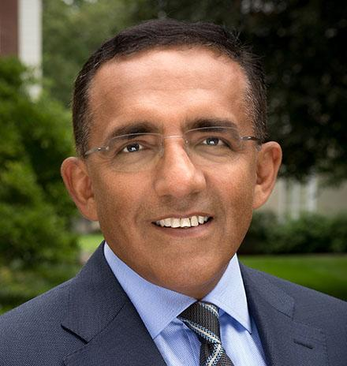

When Faultlines Go Unmanaged
“The tension between old guard generalists and the new domain experts can be palpable on multiple fronts…”
  As demands for functional expertise often outstrip early employees’ abilities to keep up, functional leadership titles increasingly go to outsiders, while legacy folks grow resentful.
  Early employees may chafe against the narrowing confines of their changing roles (generalists may not want to be specialists).
“Frustrated, they leave, taking valuable relationships and tacit understanding of the firm’s mission and culture with them.”
Ranjay Gultai (Professor, Harvard)
Alicia DeSantola (Professor, UW)

Slide 26


When Birchbox grew from 8 employees in 2010 to more than 300 in April 2014, employees’ roles and responsibilities shifted.
Consider the logistics of shipping a million boxes of unique samples each month—or the job of building sales relationships with enough partner organizations to continually fill those boxes with fresh, interesting products.
Katia Beauchamp
& Hayley Barna
Early employees lacked the knowledge and experience to handle everything on their own as the company grew. So Birchbox divided the work into specialized functions and sought out domain experts.
The new hires included a CTO with a computer science PhD from Carnegie Mellon and a vice president of brand campaigns who had been a principal at Booz & Company.
Notes:
Birchbox is a New York City-based online monthly subscription service that sends its subscribers a box of four to five selected samples of makeup, or other beauty related products. The products include skincare items, perfumes, organic based products, and various other cosmetics.

Slide 27
What Birchbox Did
1. Emphasized and celebrated the “old guard.”
Cofounder Katia Beauchamp agrees about the importance of appreciating the old guard as essential to Birchbox’s special sauce. She says, “I think we do a really good job of showing people how valuable their skill sets are and celebrating the fact that we wouldn’t be here without their collective capabilities. ” That attitude kept early employees feeling valued and engaged.
2. Established focus around the “new task at hand.”
Reminding the old guard of the challenges ahead and the ways in which experienced talent could help got the old guard focused on the greater good of the firm instead of worrying about their relevance and status in the new order. Beauchamp says that she and cofounder Hayley Barna “worked really hard to get people to believe that you can hire people better than you. ”

Slide 28
What Birchbox Did
3. Involved and amplified voice.
Involving members of the old guard in hiring process assured them they would still have a voice. The founders also talked with them about how the domain experts could mentor them and help them develop niches in the growing firm.
4. Cultivated a learning mindset.
Matt Field, a former early employee who headed international operations during the big growth phase, saw that as an opportunity for personal development. “I knew I did not have the background or knowledge to take Birchbox to the level of aspiration we had, ” he says. “I hired someone who could teach me and empower me to get better at my job.”

Slide 29
What Birchbox Did
5. Brought in new people who respected the way things have been.
“When I walked in and looked objectively at certain monthly processes, I saw that they had been established in a hacked together way, ” said Kate Price, the new VP of brand campaigns. “My consultant mind immediately went to thinking that we should fix all those things, but I learned pretty quickly to respect the people who at the age of 24 had built a process that was part of the engine keeping the company running. ”
6. Appreciated and leveraged what each group could offer.
As more outsiders joined and settled into functional divisions, early employees provided cohesion through their broad understanding of how the components of the business model fit together and their deep cultural knowledge. “The old guard didn’t come in with as much industry experience, but they are superskilled at ‘Birchbox’—at our vision and practices,” Beauchamp remarked.

Slide 30
REFLECT AND APPLY
20 min: Looking again at the scaling plan that you drafted on Day 1, consider how you will need to grow your team. Will you need to shift from generalists to specialists? Add new management layers? Adopt a more formal team culture?
20 min: Considering the changes you anticipate, which present the biggest challenge to you? Is it having hard conversations/replacing existing members? Is it finding people who are skilled and that you trust? What faultlines might emerge and how do you plan to manage them?

Slide 31
Growing Your Team: Takeaways
Remember: “The team you need tomorrow is not the team you have today.”
When expanding your team, be aware of how the shift from to specialization, new management layers, and formal team culture may require hard questions of who in your current team can/are willing to change.
If adding to/subtracting from your team, utilize strategies to proactively manage the faultlines that may emerge between the old and new.

Slide 32
Leadership Strategies for Scaling
2:00-5:00
Growing
A Culture of Innovation
How do you foster a culture where great ideas are developed, nurtured, and bring competitive advantage?
11:00-12:30
Growing
Your Team
What strategic factors should you consider when growing your team?
9:00-10:45
Growing
Yourself
To prepare for growth, what must shift in who you are as a leader?
Notes:
Email all material a week before (printouts etc., powerpoints)
9 a.m. actual content start but be there at 8
Take an hour ½ lunch somewhere in there
End at 5
N = 50
I’m going there are at least three ways in which your mindset has to shift, has to grow.
One is, growing who you are as a leader.
Two is, growing your team.
Three is, growing

Slide 33

Notes:
Occurs in individuals
Catalyzed in teams
Nurtured by leaders

Slide 34
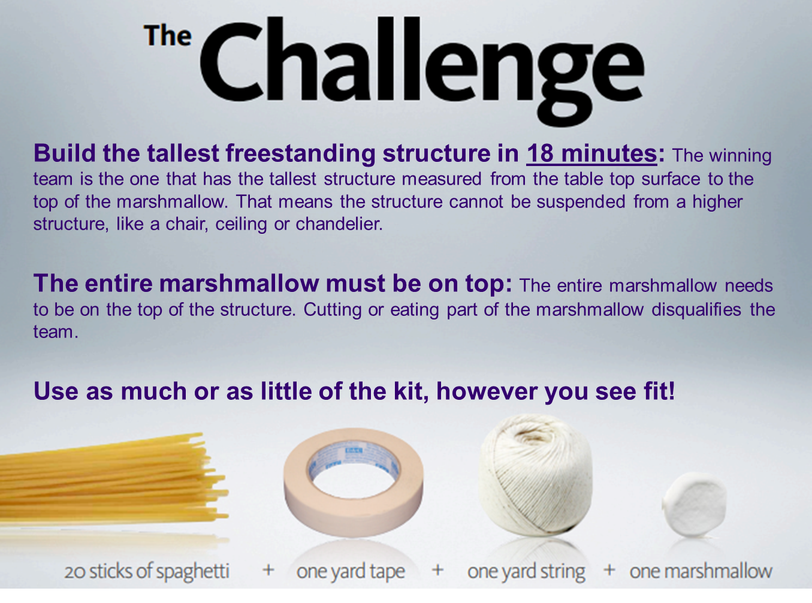
Notes:
This challenge has been conducted by tens of thousands of people in every continent, from the CFOs of the Fortune 50 to Students at all levels. The lessons learned are universal.
Prizes: standing ovation
Play music when they’re playing: https://www.youtube.com/watch?v=soXQiu5Nrn4
Display timer as they’re going: https://www.youtube.com/watch?v=tJan3T4h5ok
17 people = 3 + 3 + 3 + 4 + 4

Slide 35


What was the secret to your success?
What led to your downfall?
What did this exercise reveal about
the way you approach a culture of
innovation?
Notes:
http://www.threestonesconsulting.com/lessons-learned-from-the-marshmallow-challenge/
Dell’Acqua et al. (2025): We examine how artificial intelligence transforms the core pillars of collaboration—performance, expertise sharing, and social engagement—through a pre-registered field experiment with 776 professionals at Procter & Gamble, a global consumer packaged goods company. Working on real product innovation challenges, professionals were randomly assigned to work either with or without AI, and either individually or with another professional in new product development teams. Our findings reveal that AI significantly enhances performance: individuals with AI matched the performance of teams without AI, demonstrating that AI can effectively replicate certain benefits of human collaboration. Moreover, AI breaks down functional silos. Without AI, R&D professionals tended to suggest more technical solutions, while Commercial professionals leaned towards commercially-oriented proposals. Professionals using AI produced balanced solutions, regardless of their professional background. Finally, AI’s language-based interface prompted more positive self-reported emotional responses among participants, suggesting it can fulfill part of the social and motivational role traditionally offered by human teammates. Our results suggest that AI adoption at scale in knowledge work reshapes not only performance but also how expertise and social connectivity manifest within teams, compelling organizations to rethink the very structure of collaborative work.
Dell’Acqua et al. (2023): The public release of Large Language Models (LLMs) has sparked tremendous interest in how humans will use Artificial Intelligence (AI) to accomplish a variety of tasks. In our study conducted with Boston Consulting Group, a global management consulting firm, we examine the performance implications of AI on realistic, complex, and knowledge-intensive tasks. The pre-registered experiment involved 758 consultants comprising about 7% of the individual contributor-level consultants at the company. After establishing a performance baseline on a similar task, subjects were randomly assigned to one of three conditions: no AI access, GPT-4 AI access, or GPT-4 AI access with a prompt engineering overview. We suggest that the capabilities of AI create a “jagged technological frontier” where some tasks are easily done by AI, while others, though seemingly similar in difficulty level, are outside the current capability of AI. For each one of a set of 18 realistic consulting tasks within the frontier of AI capabilities, consultants using AI were significantly more productive (they completed 12.2% more tasks on average, and completed task 25.1% more quickly), and produced significantly higher quality results (more than 40% higher quality compared to a control group). Consultants across the skills distribution benefited significantly from having AI augmentation, with those below the average performance threshold increasing by 43% and those above increasing by 17% compared to their own scores. For a task selected to be outside the frontier,
however, consultants using AI were 19 percentage points less likely to produce correct
solutions compared to those without AI. Further, our analysis shows the emergence of
two distinctive patterns of successful AI use by humans along a spectrum of human-
AI integration. One set of consultants acted as “Centaurs,” like the mythical halfhorse/
half-human creature, dividing and delegating their solution-creation activities
to the AI or to themselves. Another set of consultants acted more like “Cyborgs,”
completely integrating their task flow with the AI and continually interacting with
the technology.

Slide 36
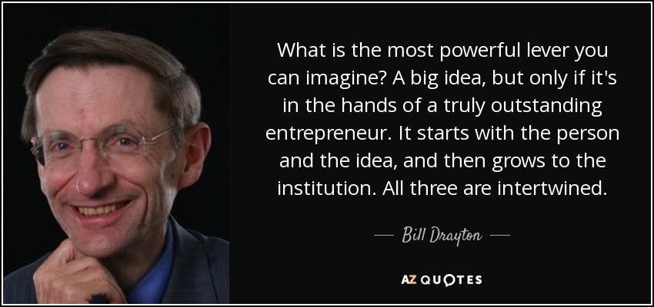
Notes:
Known as the godfather of social entrepreneurship (innovative solutions to society’s most pressing social problems), elected as one of the early MacArthur Fellows for his work, including founding Ashoka: Innovators for the Public.

Slide 37
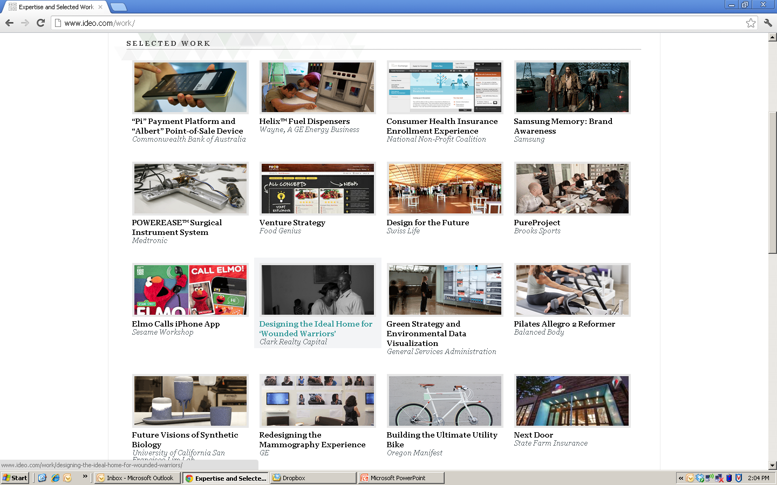
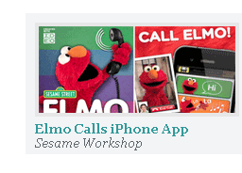
IDEO Product Design
Founded in 1991
Award-winning global design firm
  #10 on Top 25 Most Innovative Companies (Fast Company)
  One of the most innovative companies in the world by Boston Consulting Group (BusinessWeek)
Notes:
So what are the key ingredients to creativity in action? Let’s go behind the scenes in this video showing how IDEO, an award winning global design firm, approaches their creative process.

Slide 38


Innovation Culture at IDEO in Action
As you watch the video clip, think about:
What are some of the critical practices that enable IDEO’s innovation culture?
Notes:
9 minutes
https://www.youtube.com/watch?v=M66ZU2PCIcM
Use white board to discuss:
-creative people
-creative process
-creative leadership

Slide 39

Building a Culture of Innovation
  Step #1: Empower diverse teams to generate new ideas in response to key problems.
  Step #2: Make it psychologically safe for new ideas to be shared, experimented with, and refined.
  Step #3: Operate in “inquiry” and say “yes and…” to discover the value of new ideas.

Slide 40

Where Do New Ideas Come From?
The ability to see relationships or links between things usually not linked – e.g., new uses for old ideas, new combinations of existing ideas
In 1 minute, list as many different uses for a paper clip as you can.
Now exchange your list with the person next to you and highlight ideas that are “uncommon.” What led you to generate those ideas?
Notes:
Not just your experiences, but also the people who you exchange ideas with!

Slide 41
How Diversity Produces New Ideas
When members are homogeneous, they have similar experiences and are directly linked to each other
When members are diverse, they have unique experiences representing otherwise unconnected networks
TIGHT NETWORK
- Redundant information
- Pressure for conformity
LOOSE NETWORK
+ Access to opportunities and diverse information
+ Maximizes autonomy and flexibility
Notes:
In cases where everyone is connected to everyone else (i.e., a clique network), those mutual relationships foster cooperation and loyalty. But they also mean that no one has any unique information. In contrast, when you have an entrepreneurial network, you are the one who connects otherwise unconnected individuals and their networks. Because they are not connected to each other, you are able to access diverse information, which in turn facilitates your associative ability.

Slide 42
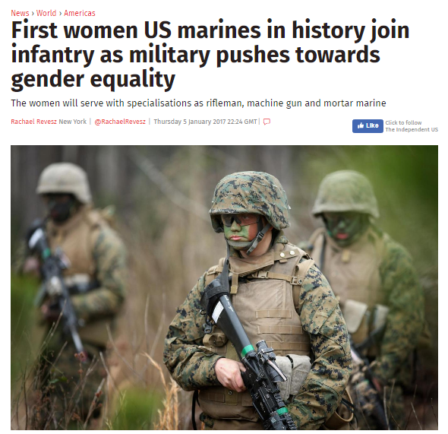
Strategy #1: Bring In Outsiders
156 enlisted men & women
“Fire teams” of 3 men & 1 female
Series of realistic team challenges
Observed who spoke up, what happened to their voice, and team performance
Farh et al. (2020)
Notes:
First strategy: Bring in outsiders
But my research suggests that minority voices are essential for creative problem-solving
Tell you about some work I’ve done on token women’s voices in the Marine Corps
USMC traditionally male dominated, women scrutinized for their physical strength, combat readiness, and leadership capabilities
Makes it harder for women to speak.
Against this backdrop, we conducted a study to better understand the conditions the enabled a lone woman in a team of males to speak up and the impact of her voice on team performance.
We observed “fire teams”… in a series of realistic team challenges.

Slide 43
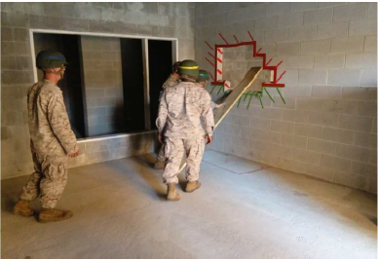
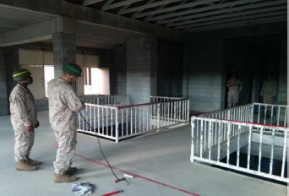
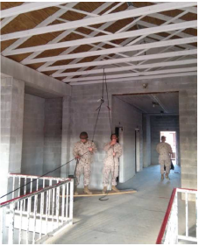
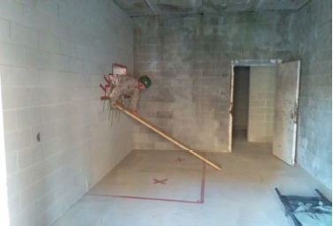
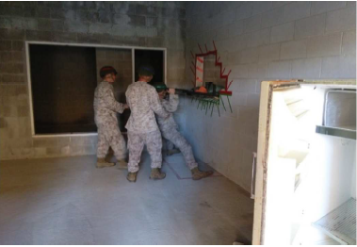
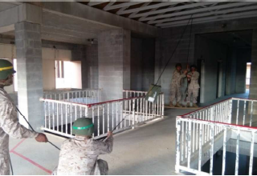
Tale of Two Tasks
Low Complexity Task High Complexity Task
Farh et al. (2020)
Farh et al. (2019)
Notes:
Here’s an example of a low and high complexity task.

Slide 44
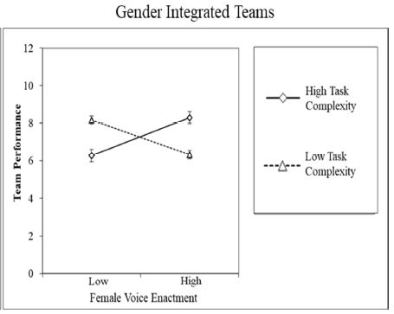
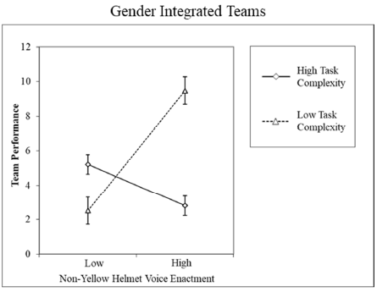
Impact on Team Performance
Female Voice Enactment
Male Voice Enactment
Farh et al. (2020)
Notes:
Our results showed the vital importance of hearing and acting on minority voices.
Although it was hard to get her voice heard, when teams with a token female DID act on her ideas, the team achieved higher performance on complex tasks (i.e., tasks with no obvious solution that required problem-solving and creativity); in fact, the team achieved higher performance on such tasks than when the team acted on the suggestions of her male counterparts.
Why? Because she had a different perspective. Acting on her ideas enabled the team to think out of the box, which enabled them to reach a creative solution more quickly than when her ideas were not enacted.
[CLICK] In contrast, when it was a low complexity task – meaning, creativity and divergent perspectives were not needed – acting on the male majority’s voice led to higher performance.

Slide 45
Strategy #2: Send Insiders Out (like IDEO)
TIGHT/”INSIDERS”
Determine practical feasibility of ideas.
Refine ideas.
Provide operational know-how to implement change.
Create systems to support ideas.
Champion innovation.
Ideas are made implementable here.
LOOSE/ “OUTSIDERS”
Newcomers, suppliers, clients, R&D labs, friends.
Experts representing different facets of the problem.
Increased in externally focused networks.
Idea connectors.
New ideas come from here.
Notes:
Second strategy: Send Insiders Out
Doesn’t mean clique networks aren’t helpful. They are.
http://www.theglobeandmail.com/report-on-business/economy/growth/how-outsiders-solve-problems-that-stump-experts/article4104220/?page=1

Slide 46



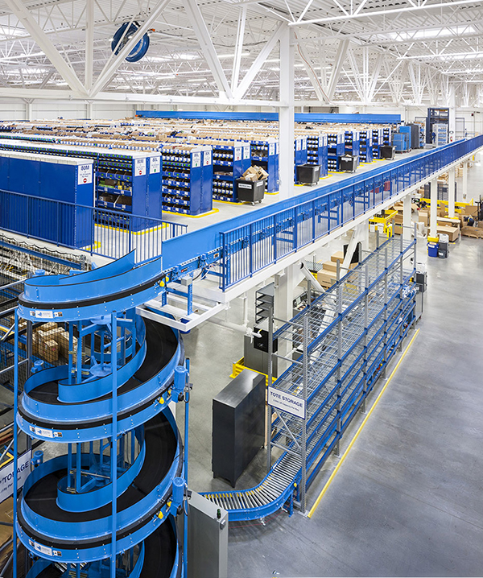
Strategy #3: Follow an “In-Out-In” Process
Notes:
What does it look like to create a system that fosters individual creativity?
A few years ago, I won the Paccar Award for teaching excellence from MBA class of 2019
PACCAR – leading truck manufacturer HQ in Bellevue
Perk of winning the award was a tour of one of their part distribution centers
What I saw amazed me!
Employees asked to generate ideas every two weeks to their peers and to leadership.

Slide 47
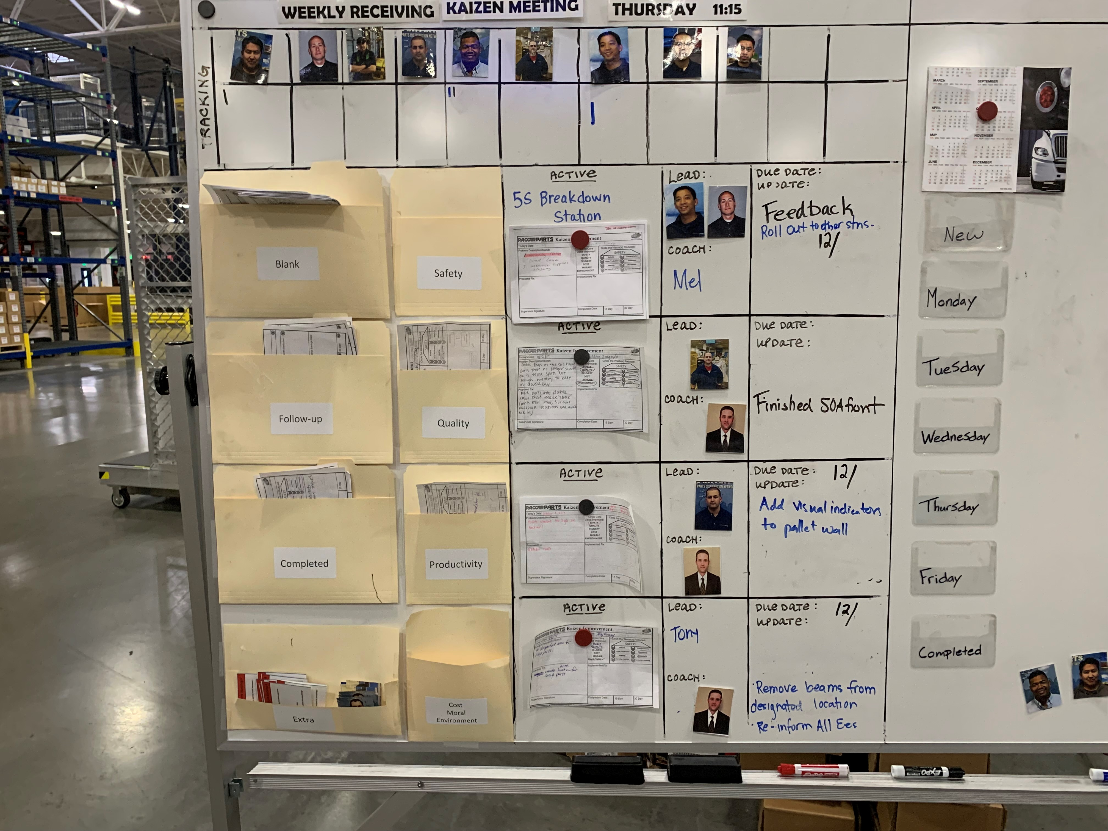
In: Clear “what is useful” guidelines
Out: Regular rotation across functions every 2 months
In: Idea implementation meetings every two weeks
Notes:
Third strategy: Turn Insiders into Outsiders
How did they enhance novelty? Rotation.
How did they enhance usefulness? Guidelines
[CLICK] If anyone had an idea, they had to articulate how their idea addressed a problem related to three key metrics that mattered for the bottom line: [CLICK]safety, quality, and productivity
Their peers then voted on whether an idea should be implemented, and [CLICK] then the person with the idea was paired with a member of leadership to implement the idea
And that’s not all. They had a system for follow up and maintained a history of ideas that worked or did not work, valuable information that could be used to benchmark future ideas.
Do you see what’s happening here? They created a system that essentially “coached” employees to produce novel and useful ideas

Slide 48
Take away #1:
Empower people to generate
new ideas…
…by inviting them IN on a worthwhile problem…
…sending them OUT to access new perspectives…
…and bringing them back IN and partnering to make those ideas useful for your context.
Notes:
Especially in a diverse team where jargon etc. and information may not be readily shared.
SHARE IT.
Not doing so would be like hoping people will give input but not inviting them to the meeting.

Slide 49
Building a Culture of Innovation
  Step #1: Empower diverse teams to generate new ideas in response to key problems.
  Step #2: Make it psychologically safe for new ideas to be shared, experimented with, and refined.
  Step #3: Operate in “inquiry” and say “yes and…” to discover the value of new ideas.

Slide 50
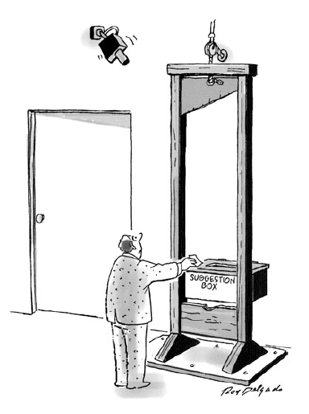
The Problem with Sharing New Ideas
People hold back if…
“Target Identification”–they believe others (read: founders) identify with the status quo, so new ideas may be construed as personal criticism
“Lack of Data”–they believe they need to have solid data, polished ideas, or complete solutions before speaking up (but new ideas are rarely completely known)
“Public Voice”–they believe speaking up with new ideas that challenge, question, contradict, or expose others in meetings will be interpreted as disloyal or culturally unacceptable
“Career Consequences”–they believe they are rewarded for “going along quietly” rather than being a change agent
  …Even more risk when (a) you raise concerns versus suggestions, and (b) when you’re not a part of the majority group (e.g., new hires, demographic minorities)
  Burris et al. (2012); Detert & Edmonson (2011); Howell et al. (2015)
Notes:
If you’ve empowered people to come up with game-changing ideas, then you might think they will speak up and share those ideas so that they’ll be enacted…
BUT…

Slide 51

Solution: Psychological Safety
Psychological safety is the shared confidence and trust that the team will not embarrass, reject, or punish someone for expressing disagreement, challenging others’ views, making a mistake, showing personal weakness.

Slide 52
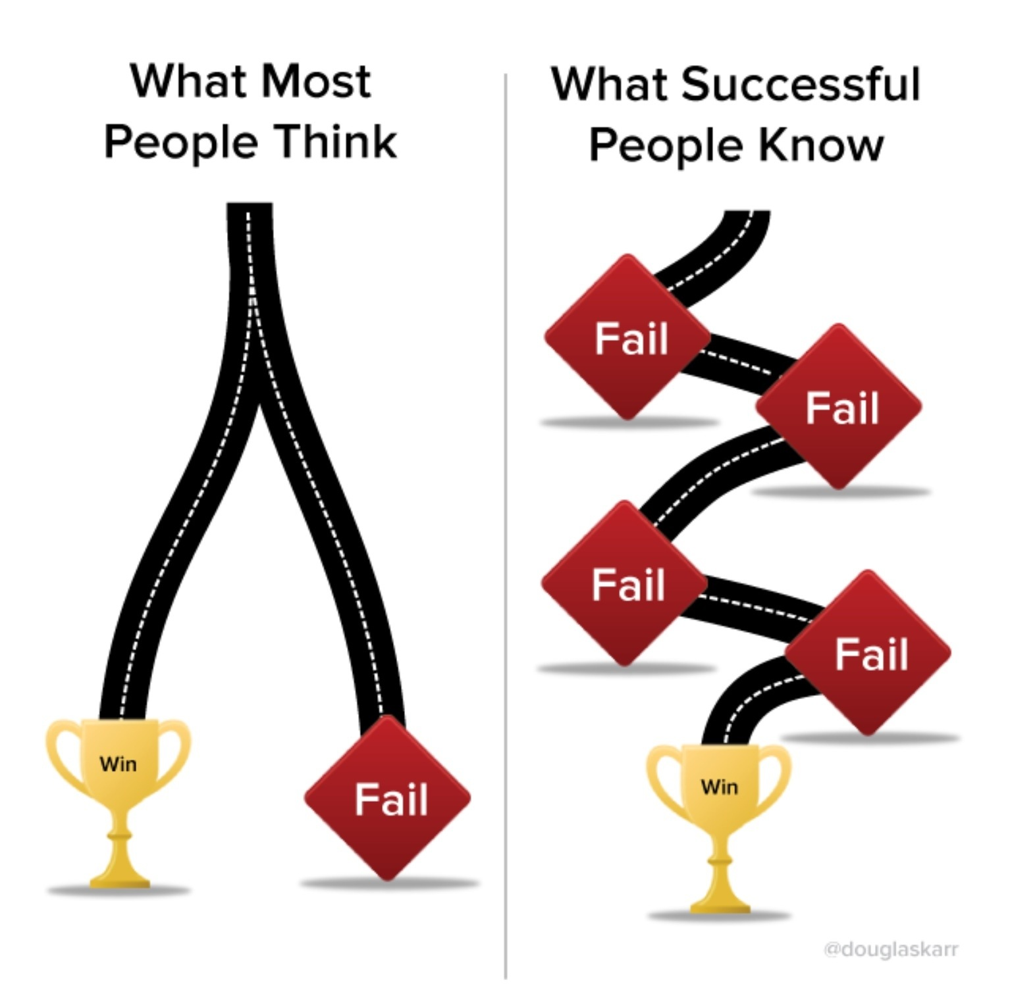
How Did IDEO Build Psychological Safety?
Leaders showed humility and receptivity – Openly shared the limits of their knowledge and the need to rely on other perspectives.
Leaders emphasized the need to “build on” ideas – Showed enthusiasm for ideas of all kinds, recognizing contributions publicly.
Leaders promoted a learning culture – Encouraged experimentation, viewing failures as learning opportunities and the starting point for improvement.

Slide 53
Take away #2:
Make it safe to speak up…
…otherwise new ideas will never surface and never achieve “game-changing” status
Notes:
Especially in a diverse team where jargon etc. and information may not be readily shared.
SHARE IT.
Not doing so would be like hoping people will give input but not inviting them to the meeting.

Slide 54
Building a Culture of Innovation
  Step #1: Empower diverse teams to generate new ideas in response to key problems.
  Step #2: Make it psychologically safe for new ideas to be shared, experimented with, and refined.
  Step #3: Operate in “inquiry” and say “yes and…” to discover the value of new ideas.

Slide 55

Unfortunately, Sometimes We Are Hard of Hearing
Think of a song that may have been playing in your mind lately.
To a partner, clap the rhythm of that song. See how many tries it takes before they can guess the song. Then switch.
What makes this exercise so difficult?
Notes:
We often have this experience when we are conveying a new concept to others that we want them to adopt or implement.
Exercise shows that it’s especially hard when people have different ideas in their minds. Only you know the tune in your head, but conveying that to someone else is extremely difficult.
This is also one of the central challenges of leadership – aligning people to your vision and bringing them to action.

Slide 56
Faultlines Make it Harder to Hear
 | Company tenure (yrs) | Functional expertise | Reward Structure | Relationship to Founder
Member 1 | 3 yrs | Generalist | Low cash, high equity | Family member
Member 2 | 5 yrs | Generalist | Low cash, high equity | Personal friend
New Hire 1 | Less than 1 yr | Specialist (Marketing) | High cash, low equity | No pre-existing relationship
New Hire 2 | Less than 1 yr | Specialist (HR) | High cash, low equity | No pre-existing relationship
Notes:
5 minutes - Simplex Solutions Worksheet 3
Research on diversity suggests that it has opposing effects. On the plus side, diversity helps teams process information. It increases the amount of available information and thus can help teams achieve better and more creative solutions.
On the minus side, diversity can cause people in teams to categorize each other into social groups. This makes it difficult for teams to communicate and cooperate because they don’t really trust the team members that they perceive to be in different social categories from themselves.

Slide 57
Solution: Focus on Inquiry, Not Advocacy…
Two approaches to group decision making | Advocacy | Inquiry
Purpose of discussion | Persuasion and lobbying | Testing and evaluation
Concept of decision making | A contest | Collaborative problem solving
Participants’ roles | Spokespeople | Critical thinkers
Patterns of behavior | Strive to persuade others Defend your position Downplay weaknesses | Present balanced arguments Remain open to alternatives Accept constructive criticism
Minority views | Discouraged or dismissed | Cultivated and valued
Outcome | Winners and losers | Collective ownership
Garvin & Roberto (2003)
Notes:
These tips keep the conversation constructive

Slide 58



…By Starting with “Yes, and…”
Imagine that you and a partner work for an ad agency.
Your client is Corona. They make beer and run
beach ads – but are looking for something new.
Find a partner.
The challenge – you have different objectives but must collaborate to create a new ad in 10 minutes.
  Creative Director
  Create a new print ad for Corona that meets your brand objectives.
  Account Manager
  Collaborate with your creative director to ensure the ad meets Corona’s new business objectives.
Notes:
Creative director – It’s the laid-back brew that wants us (the hardworking adult) to find our beach and enjoy the relaxing, refreshing feeling after drinking (with the requisite lime).
Account manager – Wants to appeal to millennials who are physically active and high-octane seeking millennials who might enjoy a beer while engaged in everyday life (as opposed to waiting to go on vacation or being sedentary on the beach).

Slide 59
“Yes, and…” vs. Taboo Words
Suggests that a participant should accept what another participant has stated ("yes") and then expand on that line of thinking ("and")
Began in improv groups, but also used in business and other organizations as a principle that…
    Improves the effectiveness of the brainstorming process
    Fosters effective communication
    Encourages the free sharing of ideas
At the same time, you must avoid the taboo words!
No Can’t But Although However

Slide 60
Ready… Set… Go!
Read your objective and take 2 minutes to jot down your thoughts.
Find someone in the opposite role to pair up with.
With your partner, take 10 minutes to create your ad using the paper and pen given to you.
Be prepared to present your ad in small groups!
Large Group Reflection Questions:
  Was it hard to use the “Yes, and…” principle? Why?
  When were you most tempted to use the “taboo” words?
  What did it feel like on the receiving end of “Yes”?
Notes:
Yes and facilitates creativity, flow, and allows an idea to evolve and grow!!!

Slide 61
Take away #3:
Those at the top are sometimes least able to understand and appreciate the value of new ideas…
So actively work to stay in inquiry and start with “Yes, and...” until the value of an idea is known
Notes:
Especially in a diverse team where jargon etc. and information may not be readily shared.
SHARE IT.
Not doing so would be like hoping people will give input but not inviting them to the meeting.

Slide 62
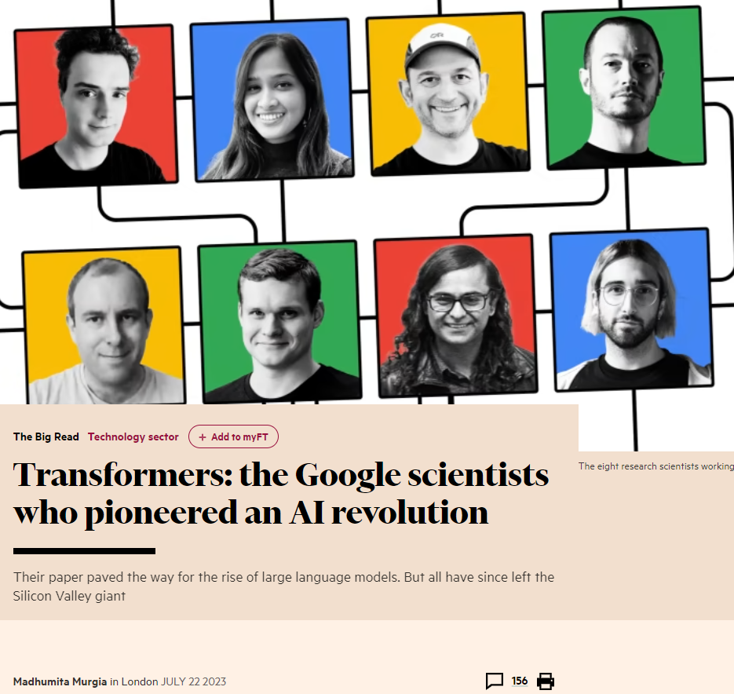
A Culture of Innovation in Action
Notes:
A recent Financial Times article tells the story of the diverse team that gave rise to the generative AI revolution.
Individuals from eight different countries. One woman, seven men. A range of ages and backgrounds. It all started with a couple of Google scientists trying to figure out how to improve the language processing capabilities of Google Translate.
According to the article, someone by the name of Illia Polosukhin (pa-LAH-shu-kin)– a science fiction fan from Kharkiv (car-KEEV) in Ukraine – had the idea that if only he could teach the AI technology behind Google Translate to analyze and decode entire sentences, as opposed to scanning each word and translating them sequentially, the translation process would not only be vastly sped up; it would also be more contextually accurate. Where did Illia get this idea? Science fiction. In fact, this new translation process was a lot like how human linguists translated the alien language in the film Arrival, a sci-fi box office hit at the time.
Research suggests that Illia, an immigrant from Eastern Europe, would have probably been better off keeping his wild, fiction-fueled ideas to himself. Yet astonishingly, the article goes on to report that Illia, alongside two other AI researchers, Ashish (ah-SHEESH) Vaswani and Jakob Uszkoreit (OOz-kor-ite), decided to test out some early prototypes on English-German translations and found that it actually worked. At that point, Noam Shazeer (sha-ZEER), a Google veteran and leader figure, to jump in, saying “I’m with you… let’s do it, this is going to make life much, much better for all AI researchers.” His buy-in resulted in a formalized, months-long collaboration that eventually produced “the transformer” which went on to become the cornerstone of most cutting-edge applications of AI in development today. And the rest is now history in the making.
When it comes to evaluating creative ideas, managers are shown to be allergic to novelty and tend to be most threatened by ideas that disrupt the status quo. Managers in Noam’s position are often more interested in championing their own ideas or at least ideas from someone who shares their credentials; not the ideas of someone who is more junior, from a different culture, from a different division… essentially someone who sits on the other side of a great, interpersonal divide. So why was Noam ready to jump in?
Maybe it’s because he understood, that as a long-timer, he wasn’t going to be the one bringing the novelty. Maybe he knew, that as a long-timer, his secret sauce was to make novel ideas useful and make the impossible feasible. He was an “idea coach” whose job it was to provide whatever advice, resources, and access that was needed to make the idea not just a reality but truly value-adding. A coach’s mentality is all about growth. And a coach understands that best ideas often don’t start that way, but rather are molded to become more and more valuable over time.

Slide 63
Leadership Strategies for Scaling
2:00-5:00
Growing
A Culture of Innovation
How do you foster a culture where great ideas are developed, nurtured, and bring competitive advantage?
11:00-12:30
Growing
Your Team
What strategic factors should you consider when growing your team?
9:00-10:45
Growing
Yourself
To prepare for growth, what must shift in who you are as a leader?

Slide 64
